Slide 1
Open API Introduction
Open API as a Bluemix Service
OpenWhisk Introduction
Q/A

Slide 2
OpenWhisk Introduction Garbage Char Detection from git to slack Zhi Yong Fu 2016/12/20
Globalization Shared Services Center

Slide 3
AGENDA
OpenWhisk Overview
Example : Garbage Char Detection from Git to Slack
Github Service
Customized Service - Garbage Char Detection
Slack Service

Slide 4
OpenWhisk OVERVIEW (1/5)
OpenWhisk lets you focus on writing code and building great solutions, without the hassle of setting up, configuring, or maintaining servers. You only pay for the time your code actually runs*, which means no excess capacity or idle time. OpenWhisk scales to fit your exact demand, from once a day to thousands of parallel requests per second.
Invoke your code directly via a REST API, or in response to Bluemix services and third party events.
OpenWhisk Components
Actions
Triggers & Rules
Sequences
Action Runtimes

Slide 5
OpenWhisk OVERVIEW – Actions (2/5)
An OpenWhisk action is a piece of code that performs one specific task. An action can be written in the language of your choice.
An action performs work when invoked from your code via REST API. Actions can also automatically respond to events from Bluemix and third party services using a trigger.

Slide 6
OpenWhisk OVERVIEW – Triggers & Rules (3/5)
A trigger is a declaration that you want to react to a certain type of event, whether from a user or by an event source. Triggers fire when they receive an event. Events are always occurring, and it's your choice on how to respond to them.
A rule associates a trigger with an action. Every time the trigger fires, the rule invokes the associated action.

Slide 7
OpenWhisk OVERVIEW – Sequences (4/5)
A sequence is a chain of actions, invoked in order, where the output of one becomes the input to the next. This allows you to combine existing actions together for quick and easy re-use. A sequence can then be invoked just like an action, through a REST API or automated in a rule.

Slide 8




OpenWhisk OVERVIEW – Runtimes (5/5)
Create actions in a variety of languages, including Node.js 6, Python, and Swift 3. You can also use any other language you prefer by putting your code into a Docker container. Develop your code in the Bluemix web-based interface, or with your favorite development IDE and use the OpenWhisk CLI to upload it.

Slide 9


OpenWhisk Example – Garbage Detection from Git to Slack
Workflow
Git2Slack
Github
OpenWhisk
Slack
Webhook
Filter
Garbage Detection
Post
F
A
A
A
This example is aiming to describe how to implement openwhisk based solution that using openwhish github service to detect changes happening in sample application code github repository, and send changed or added files to customized garbage detection service, and send the result to slack.

Slide 10
OpenWhisk Example – Sample Application
Sample Application - https://github.com/icnbrave/garbage-test-app
Deploy to Bluemix as static website
$ cf api https://api.ng.bluemix.net
$ cf login <with you bluemix ID>
$ git clone https://github.com/icnbrave/garbage-test-app.git
$ cd garbage-test-app $ touch Staticfile
$ echo "directory:visible" > Staticfile
$ cf push garbage-test-app -b https://github.com/cloudfoundry/staticfile-buildpack.git

Slide 11
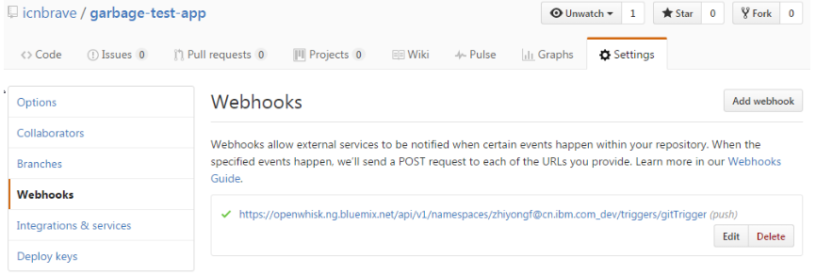
OpenWhisk Example – Create Github Trigger
Create package binding for openwhisk github for sample application
Create trigger with push event
After the trigger has been created successfully, the trigger url will be added to webhooks of icnbrave/garbage-test-app in github.
$ wsk package update myGit -p repository icnbrave/garbage-test-app \
-p accessToken <GITHUB_ACCESSTOKEN> -p username <GITHUB_USERNAME>
$ wsk trigger create gitTrigger --feed myGit/webhook -p events push

Slide 12
OpenWhisk Example – Github events and payload
Event Types & Payloads - https://developer.github.com/v3/activity/events/types/
Payload for push event:
{
……
, "commits": [
{ "id": "0d1a26e67d8f5eaf1f6ba5c57fc3c7d91ac0fd1c",
"tree_id": "f9d2a07e9488b91af2641b26b9407fe22a451433",
"distinct": true,
"message": "Update README.md",
"timestamp": "2015-05-05T19:40:15-04:00",
"url": "https://github.com/baxterthehacker/public-repo/commit/0d1a26e67d8f5eaf1f6ba5c57fc3c7d91ac0fd1c",
"author": {
"name": "baxterthehacker",
"email": "baxterthehacker@users.noreply.github.com",
"username": "baxterthehacker" },
"committer": {
"name": "baxterthehacker",
"email": "baxterthehacker@users.noreply.github.com", "username": "baxterthehacker" },
"added": [ ], "removed": [ ], "modified": [ "README.md" ] } ],
….
}

Slide 13
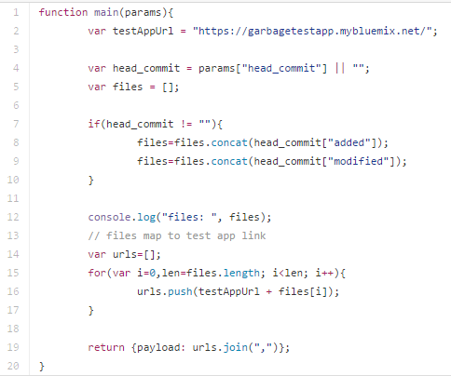
OpenWhisk Example – Create an action to receive payload from github push event
Create getPushPayloadAction with getPushPayload.js as below to receive new and changed files $ wsk action create getPushPayloadAction getPushPayload.js
Create rule git2slackRule to associate gitTrigger with getPushPayloadAction $ wsk rule create git2slackRule gitTrigger getPushPayloadAction
Then any new push event to garbage-test-app repository, trigger gitTrigger will be fired and action getPushPayloadAction will be triggerred.

Slide 14
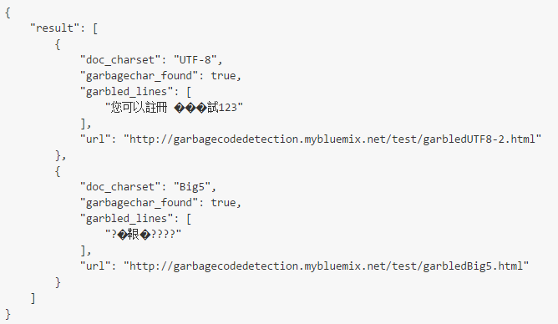
OpenWhisk Example – Garbage detection API
API: http://garbagecodedetection.mybluemix.net/rest/garbagechar_scan
HTTP Mathod: POST
Data: jsonArrayString, for example:
So create action garbageDetectionAction with garbageDetectionAction.js
$ wsk action create garbageDetectionAction garbageDetectionAction.js
Test garbageDetectionAction action
[ { "url": "http://garbagecodedetection.mybluemix.net/test/garbledUTF8-2.html", "encoding": "UTF-8", },
{ "url": "http://garbagecodedetection.mybluemix.net/test/garbledBig5.html", "encoding": "Big5", } ]
$ wsk action invoke garbageDetectAction --blocking --result -p payload http://garbagecodedetection.mybluemix.net/test/garbledUTF8-2.html,\
http://garbagecodedetection.mybluemix.net/test/garbledBig5.html

Slide 15
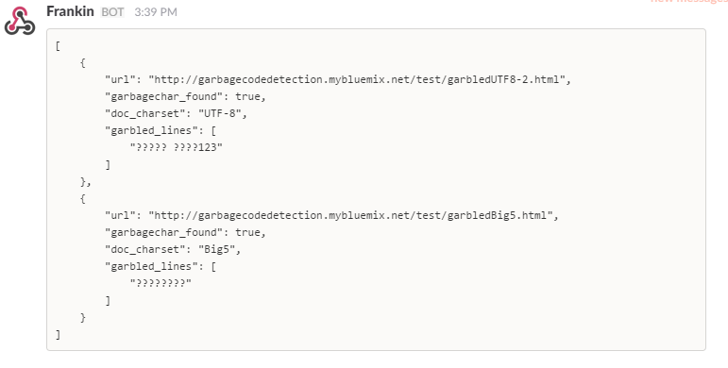
OpenWhisk Example – Send garbage detect result to slack
Configure Slack incoming webhook for your team
Create customized package with your Slack credentials
Customize slack post action with slackPost.js file
Create a action sequence git2slack to chain actions garbageDetectionAction and post2slack
Test sequence git2slack
$ wsk package create myCustomSlack --param url "https://hooks.slack.com/services/..." \
--param username Bob --param channel "#MySlackChannel"
$ wsk action create myCustomSlack/post2slack slackPost.js
$ wsk action create myCustomSlack/post2slack slackPost.js
$ wsk action create git2slack --sequence garbageDetectionAction,myCustomSlack/post2slack

Slide 16
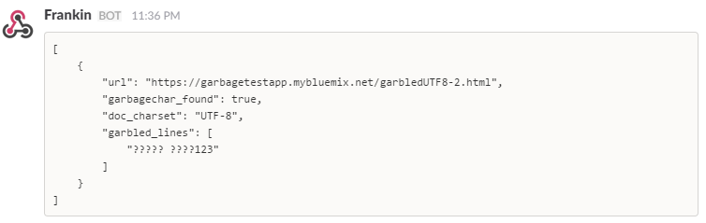
OpenWhisk Example – Update Git2Slack Sequence to chain all actions
Update git2slack to chain getPushPayloadAction, garbageDetectionAction, and mySlack/post2slack
Update git2slackRule
When you modify garbledUTF8-2.html, and push to repository, garbage detection result will be sent to slack as below:
$ wsk action update git2slack --sequence getPushPayloadAction,garbageDetectAction,myCustomSlack/post2slack
$wsk rule disable git2slackRule
$wsk rule update git2slackRule gitTrigger git2slack
$wsk rule enable git2slackRule

Slide 17
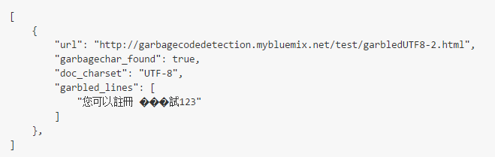
OpenWhisk Issue – Unicode unsupported
As you see the output fron Slack, the unicode characters are corrupted. The reason of corruption is that unicode char is not supported by current openwhisk version, refer to http://stackoverflow.com/questions/36812389/openwhisk-character-sets. However, we can encode all unicode char during transferring data between actions, refer to https://github.com/openwhisk/openwhisk/issues/252 for workaround.
Update garbageDetectionAction.js
And decoding the string sent to slack in slackPost.js
Update garbageDetectionAction, myCustomSlack/post2slack, and git2slack sequence.
Then, the correct result will be display to slack.
56 for(var i=0; i<ret.length; i++) {
57 ret[i]['garbled_lines'] = utils.encodeStrings(ret[i]['garbled_lines']);
58 }
44 for(var i=0,len=d.length; i<len; i++){
45 d[i]['garbled_lines'] = utils.decodeStrings(d[i]['garbled_lines']);
46 }

